Slide 1


Detecting Fraud in Synthetic Transactions: A PaySim Simulator Exploration
Team Members
Aishwarya Parida (ap63595)
Bindu Raghu Naga (br28722)
Anurag Sahu (as229468)
Aneerudh Ravishankar (ar75925)
Jahnavi Angati (ja54632)

Slide 2
Optimizing Fraud Detection: Analyzing Patterns, Applying Analytics, Enhancing Understanding
Business Question
Approach
Business Objective
Examine the synthetic dataset to understand normal mobile money transactions, unveiling inherent patterns in legitimate financial operations
How can we address the scarcity of financial datasets in mobile money transactions to improve the evaluation of fraud detection methods?
Conduct a comprehensive analysis of a synthetic mobile money dataset generated by the PaySim simulator to understand the patterns of legitimate transactions and enhance the detection of fraudulent behavior within the dataset
Utilize analytics and machine learning to identify anomalies, distinguish normal from potentially fraudulent transactions, based on dataset insights
Utilize visualization to identify patterns, and distinctions in transactions, enhancing fraud detection models and understanding mobile money dynamics

Slide 3
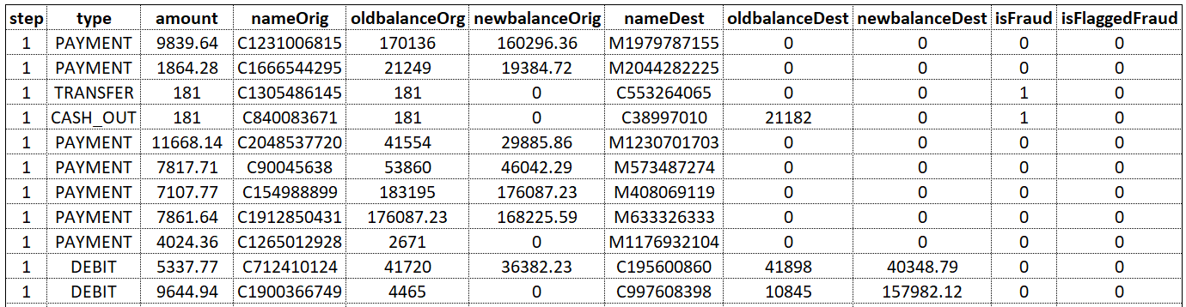
Overview of the Dataset
Variables | Description
Step | Represents a unit of time in the real world, where 1 step equals 1 hour. The simulation spans 744 steps, equivalent to 30 days
Type | Describes the type of transaction, such as CASH-IN, CASH-OUT, DEBIT, PAYMENT, and TRANSFER
Amount | Denotes the transaction amount in the local currency
oldBalanceOrg | Represent the initial and new balances, respectively, for the originating customer
newBalanceOrg
Variables | Description
nameOrig | Indicates the customer initiating the transaction
nameDest | Identifies the recipient of the transaction
oldBalanceDest | Shows the initial and new balances, respectively, for the recipient
newBalanceDest
isFraud | Flags transactions carried out by fraudulent agents
isFlaggedFraud | Flags illegal attempts within the business model

Slide 4
Data Facts and Pre-processing Observations
Scaled-down dataset from one month of African mobile money logs, excluding columns (oldbalanceOrg, newbalanceOrig, oldbalanceDest, newbalanceDest) for fraud detection due to canceled transactions
DataFrame Dimensions: (~6.3M rows, 11 columns), no immediate missing values, caution regarding potential proxies like 0
Data Quality Check: Vital for resource optimization, integrity, and accuracy; identified and removed 0 duplicates
Proxy Values Caution: Despite no apparent missing values, acknowledge potential presence of proxies, like numerical values such as 0, for further exploration
The dataset's severe imbalance (0.3% fraudulent transactions) requires careful handling to prevent bias toward genuine transactions. We address this using ensemble techniques like bagging or boosting algorithms to effectively manage class imbalance in training machine learning models.

Slide 5
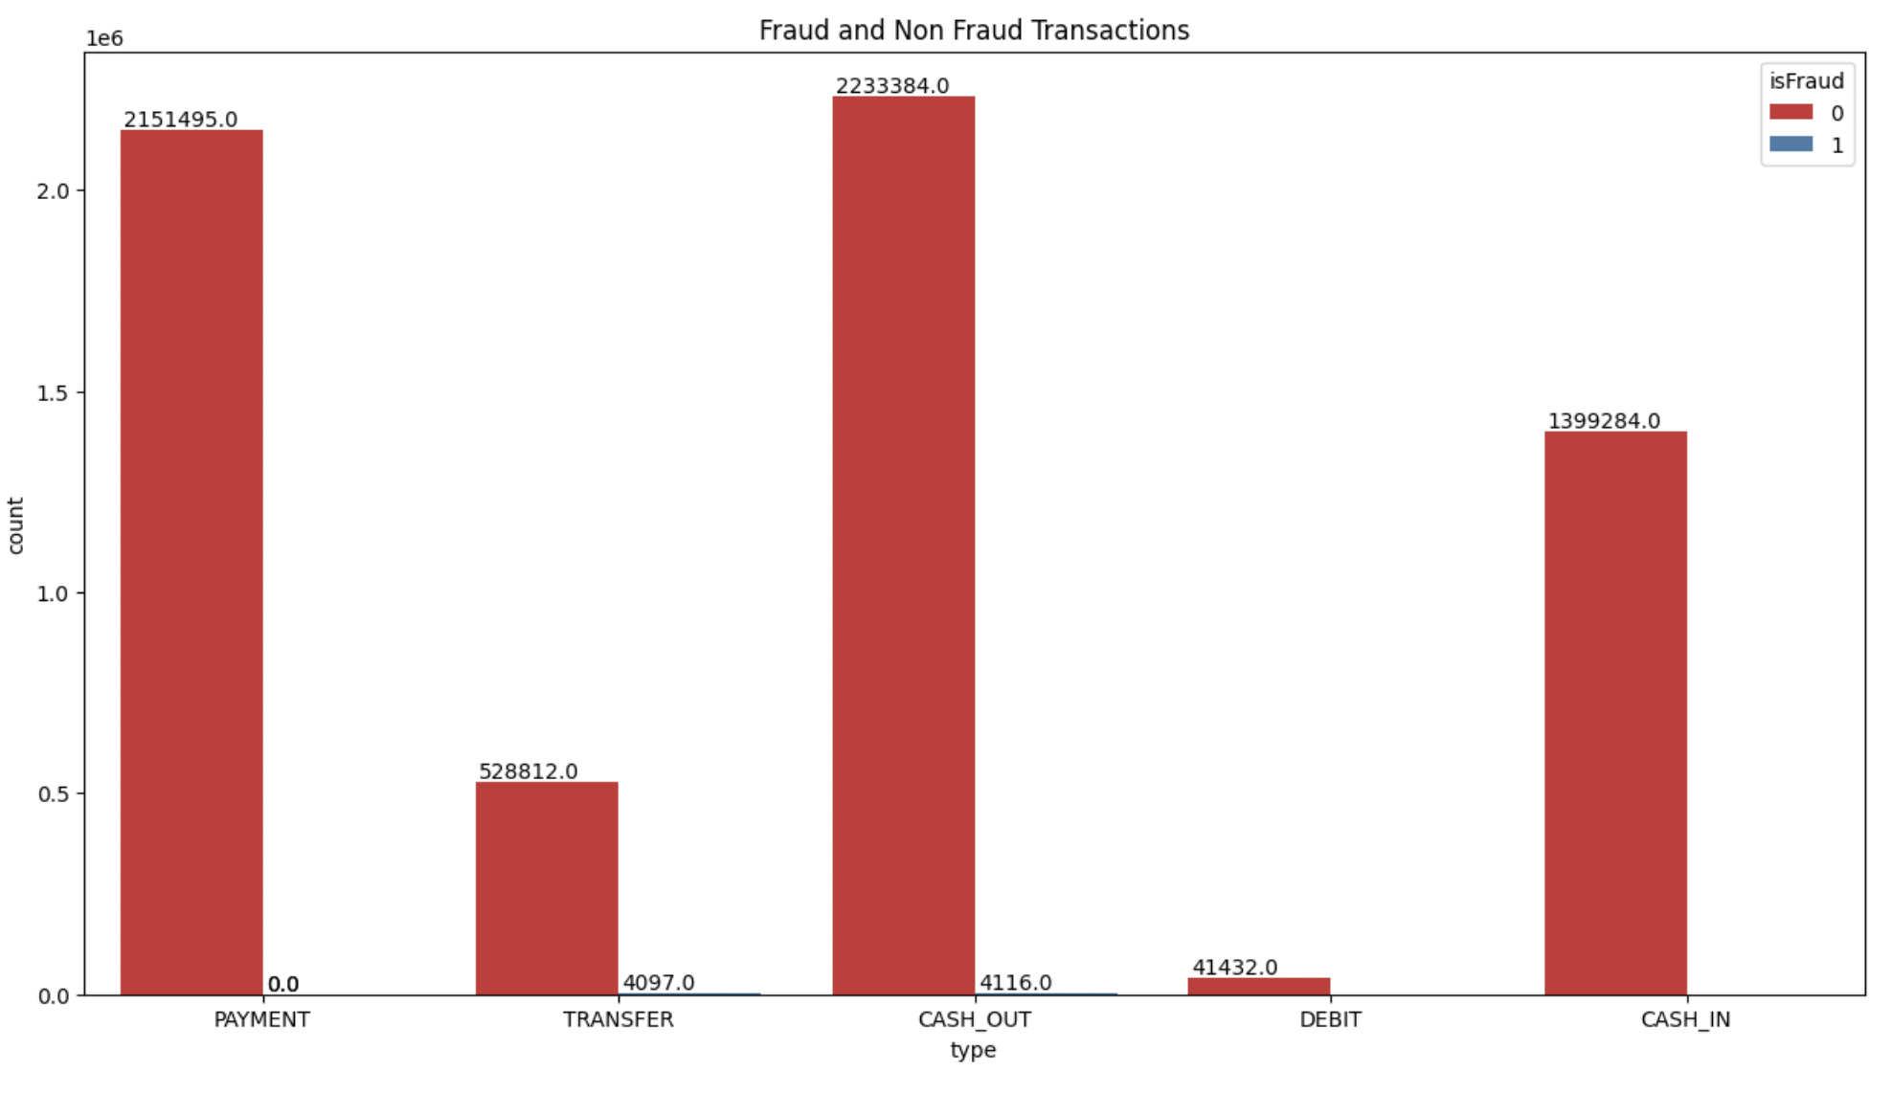
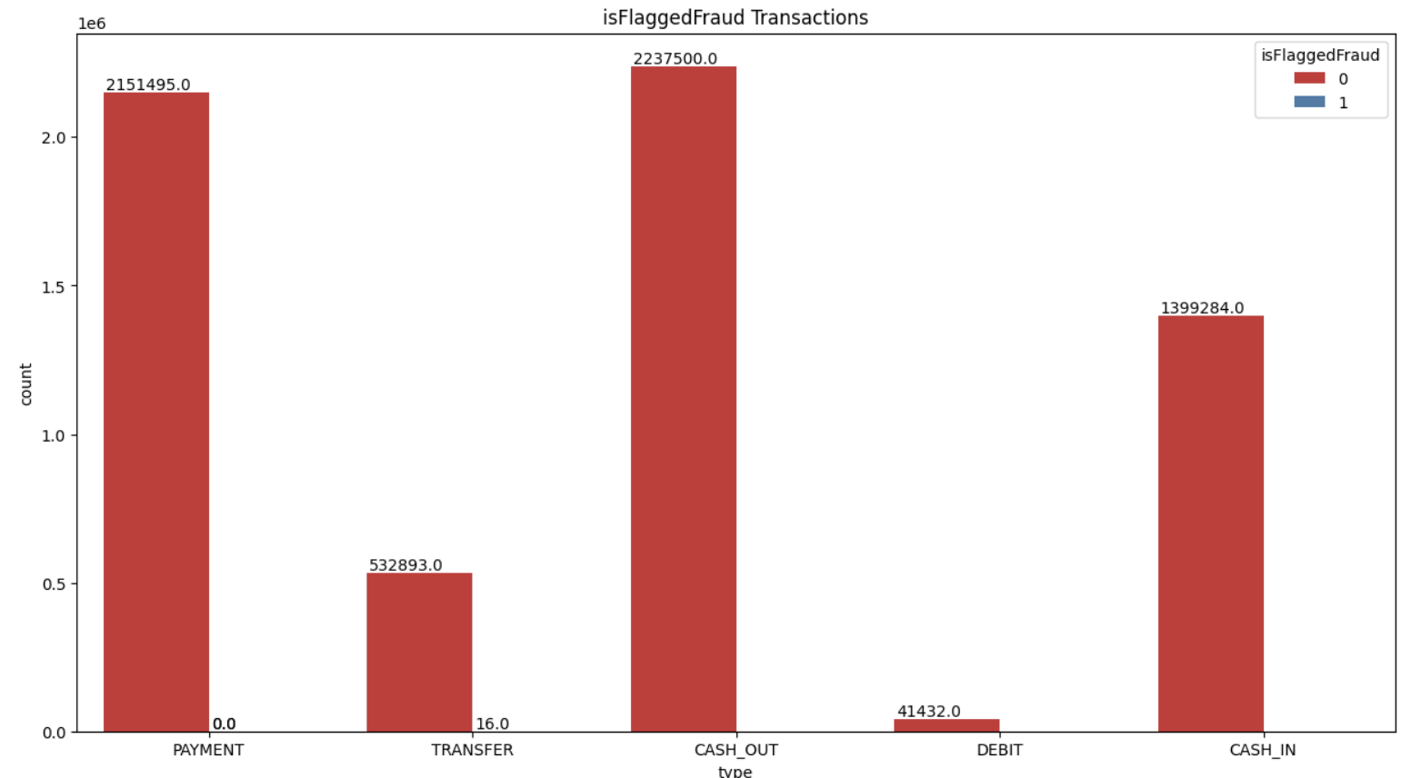
Examining Fraud Patterns: Unveiling Insights and Feature Assessment
Fraudulent Transaction Types:
Identified Types: 'TRANSFER' and 'CASH_OUT'.
Observation: Fraud detected in both types.
Instances of Fraud:
Fraudulent TRANSFERs: 4,097 instances.
Fraudulent CASH_OUTs: 4,116 instances.
Fraud Distribution Among Transaction Types:
Investigation Result: Fraud detected in only 'TRANSFER' and 'CASH_OUT'.
Notable Finding: Similar number of fraudulent instances in both types.
"isFlaggedFraud" Feature Analysis:
Occurrence: Set in only 16 instances.
Arbitrary Setting: Appears arbitrary or unrelated to any meaningful pattern.
Correlation with "isFraud":
Relationship: "isFraud" is always set when "isFlaggedFraud" is set.
Feature Recommendation:
Due to infrequent and insignificant occurrences, consider discarding "isFlaggedFraud" from the dataset without losing valuable information

Slide 6
Data Preprocessing for Fraud Detection: Cleaning, Transforming & Encoding
Conducting Data Cleaning
Selection Focus: Choosing rows where the transaction type is either 'TRANSFER' or 'CASH_OUT,' typically associated with fraud
Separating Target Variable
Isolating 'isFraud' as the target variable from the features
Removing Irrelevant Columns
Column Drop: Removing 'nameOrig,' 'nameDest,' and 'isFlaggedFraud' based on Exploratory Data Analysis (EDA)
Transforming & Encoding Columns
Binary Encoding: Encoding 'type' column as 0 for 'TRANSFER' and 1 for 'CASH_OUT.'
Conversion: Converting 'type' to an integer type for compatibility with machine learning algorithms.

Slide 7

Feature engineering
Feature Engineering enhances machine learning for fraud detection by creating two new features, 'errorBalanceOrig' and 'errorBalanceDest,' which capture errors in transaction accounts.
These features help identify potential fraud by analyzing discrepancies in balance calculations. They are calculated by comparing new and old balances with transaction amounts for both originating and destination accounts, providing valuable information for optimal fraud detection.

Slide 8
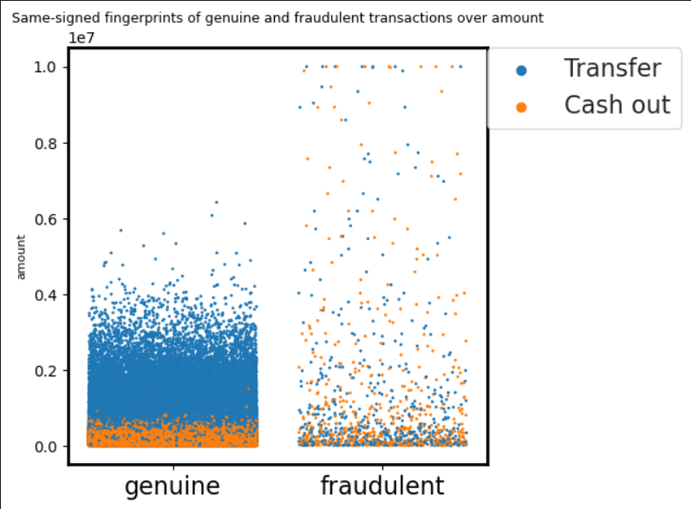
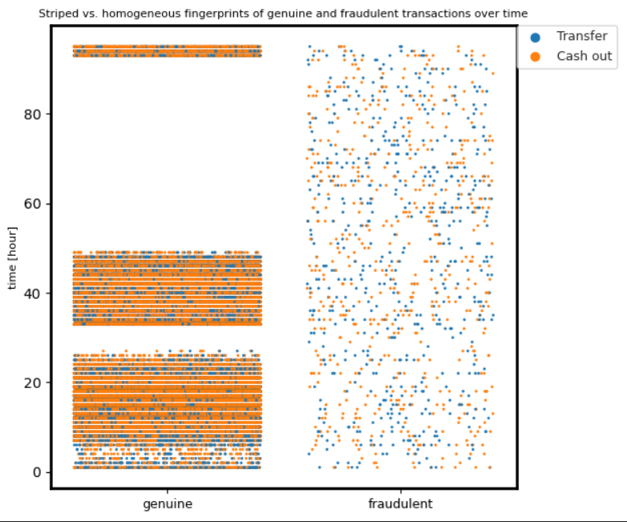
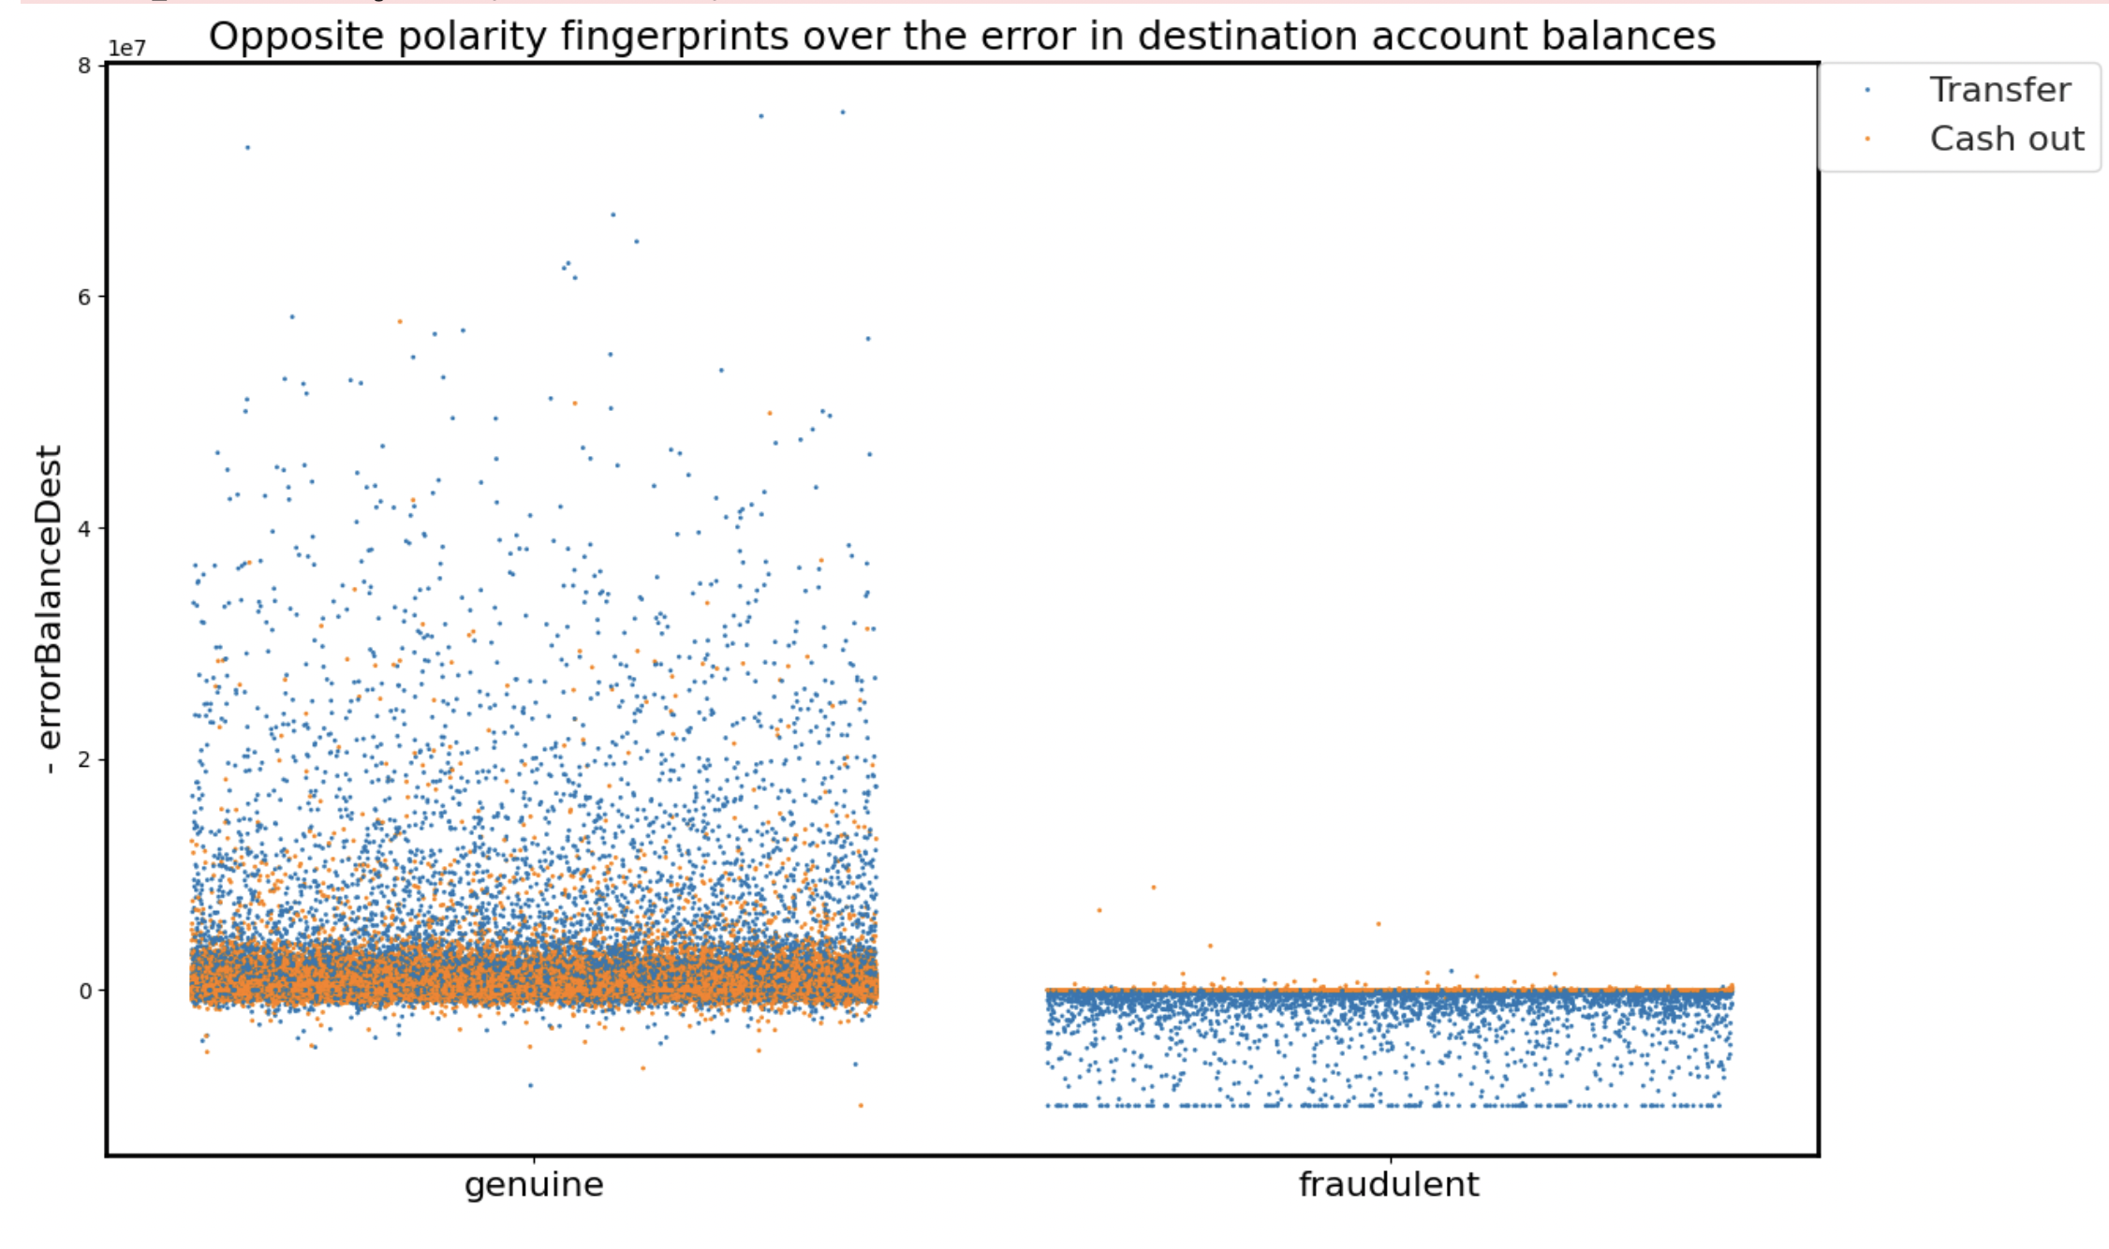
ErrorBalanceDest Analysis: Unveiling Patterns for Fraud Detection
Key Takeaways:
Monitoring 'errorBalanceDest' within the narrow range of most fraudulent data points is useful for fraud detection
The high concentration of 'Cash out' transactions among frauds indicates a distinct pattern, suggesting susceptibility or preference for fraudulent behavior

Slide 9
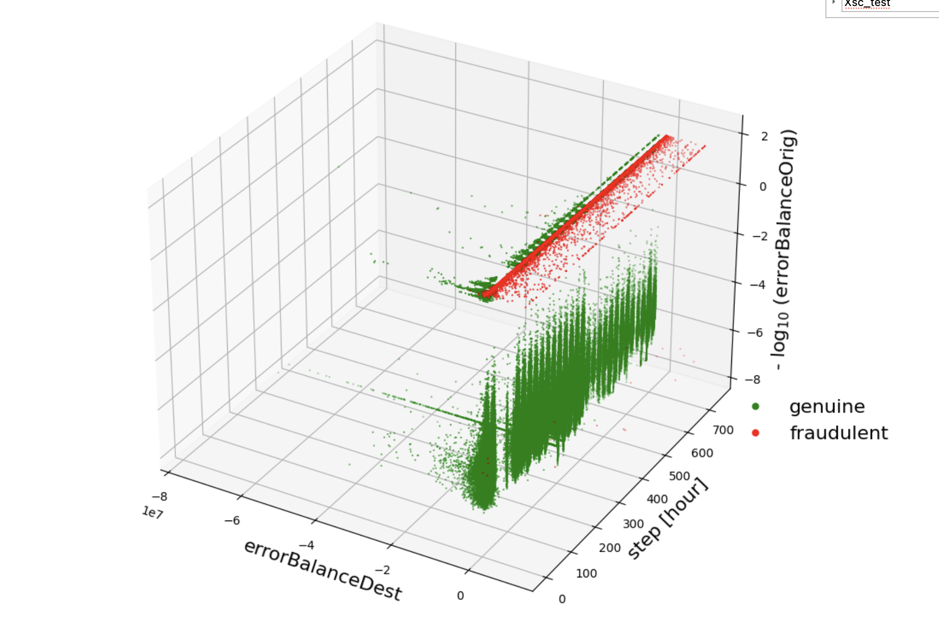
Temporal Patterns and Fraud Detection: 3D Scatter Plot Analysis
The 3D scatter plot illustrates the separation between genuine and fraudulent transactions
Clear linear separation between genuine & fraudulent transactions, with the latter forming a distinct linear pattern
Applying logarithmic transformation, particularly on 'errorBalanceDest' and 'step' axes, enhances visibility, aiding in the handling of wide-ranging values and emphasizing differences between transaction types
Effectively distinguishes genuine and fraudulent transactions; distinct clustering in fraudulent transactions indicates robust discriminatory power
Striped pattern over time on the 'step' axis indicates regular behavior; 'errorBalanceOrig' axis shows errors close to 0. In contrast, fraudulent transactions exhibit a wider range of error values
Fraudulent activities, shown on the 'step' axis (presumably time steps), are spread across the dataset, though less frequent than genuine transactions

Slide 10
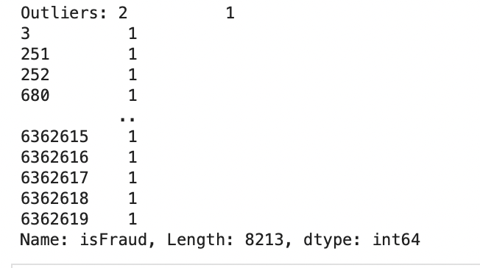
Z-Score Outlier Detection: Insights and Implications for Fraud Analysis
Z-score: It gauges outliers by quantifying the number of standard deviations a data point deviates from the mean of the dataset. This normalization tool enables comparisons across different datasets
Decision Rule: ‘isFraud’ = 1 (while exceeding the Z-score threshold, set at 3 standard deviations from the mean)
 | Actual Value | Based on Z-score
# Outliers | 8,150 | 8,213
Discrepancy in Z-score outlier counts, potentially stemming from repeated flagging of the same data point or overlapping detection, signals a need for thorough data validation to ensure accurate and reliable identification of outliers
Key Takeaways:
Accurate identification of outliers is vital in the context of fraud detection, where outliers can signify fraudulent transactions
Results should be interpreted considering potential data anomalies or duplication
Outliers represent a binary classification, indicating a substantial number of instances in fraud detection

Slide 11
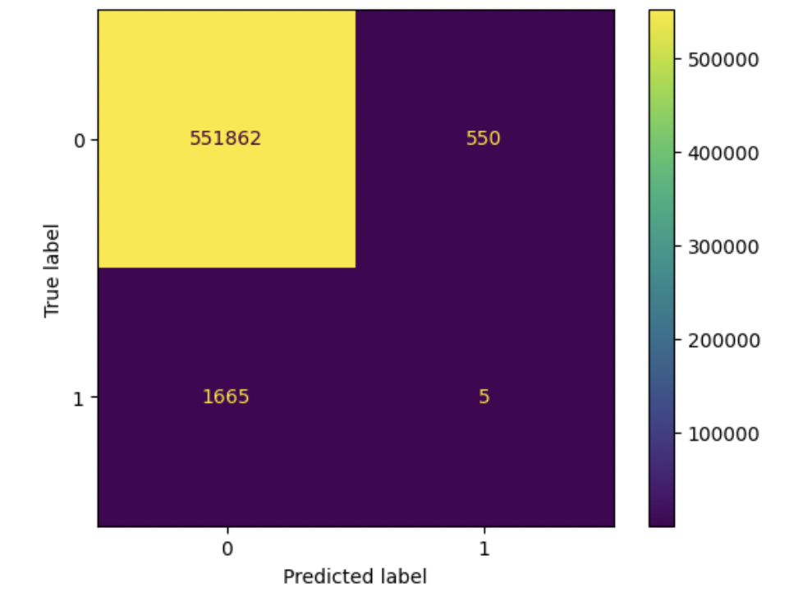
Understanding LOF Algorithm: Evaluating its Effectiveness in Fraud Detection
Local Outlier Factor (LOF): Algorithm used to identify outliers or anomalies. It operates on the principle that outliers are likely to have a lower density compared to their neighbors, thereby standing out as anomalies
The abundance of True Negatives highlights LOF's proficiency in recognizing non-fraudulent transactions
Presence of False Negatives and a low count of True Positives indicate LOF's struggle to effectively identify fraudulent transactions
The minimal count of False Positives is encouraging, signifying few instances where normal activity is incorrectly labeled as fraudulent
However, the elevated count of False Negatives is concerning, indicating a significant number of fraudulent transactions going undetected
The analysis suggests a need for further tuning or combination with other techniques to reduce the number of false negatives and improve the detection of true positives

Slide 12
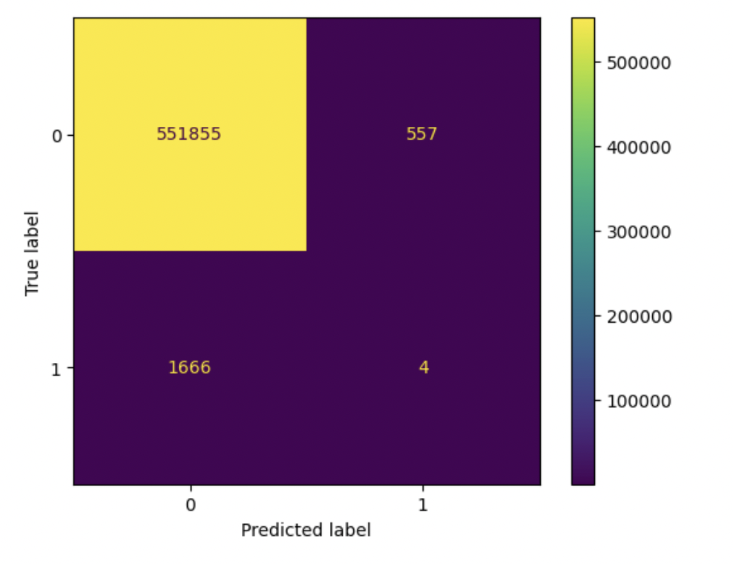
Fine-Tuning Isolation Forest: Striking a Balance for Optimal Fraud Detection
Isolation Forest: It is an anomaly detection method that isolates outliers instead of profiling normal data points
The model accurately non-fraudulent transactions, showcasing high performance in recognizing normal instances
With only 557 false positives, the algorithm demonstrates a conservative stance in flagging fraud, minimizing the occurrence of false alarms, especially beneficial in applications where such alarms are costly
Identifying 1,666 instances of missed fraudulent transactions (false negatives) suggests an area for improvement in the algorithm's sensitivity to detecting fraud
The algorithm shows high precision in detecting fraud with only 4 true positives. However, the notably low count in true positives indicates challenges in accurately isolating fraudulent transactions
Balancing improved sensitivity without a notable rise in false positives is crucial for optimizing the algorithm, emphasizing the need for further refinement and fine-tuning

Slide 13
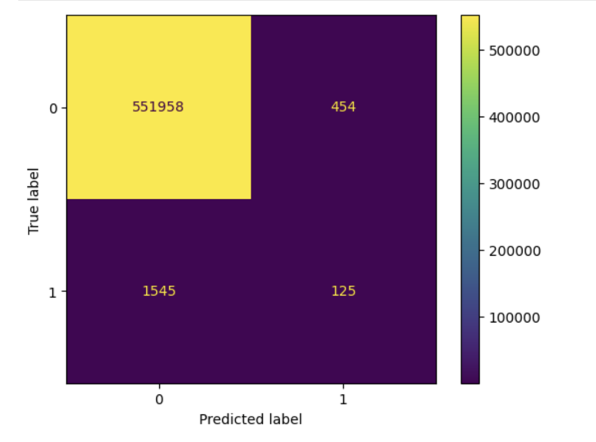
Intricacies of Outlier Detection: A Closer Look at Elliptic Envelope
Elliptic Envelope: Based on the assumption that the inliers, or normal data points, come from a Gaussian distribution. It fits an ellipse around the inliers, and data points lying outside this ellipse are considered outliers
551,958 instances correctly identified as normal, showcasing effective recognition of the majority of data within the expected distribution
Only 454 instances falsely labeled as outliers when they were normal, indicating a desirable low rate of misclassifying normal data as anomalous
125 true outliers correctly identified, but 1,545 instances of actual outliers misclassified as normal, implying a potential for missing some outliers and a lower true positive rate.
Insights suggest refining the Elliptic Envelope model by adjusting its contamination parameter or incorporating additional outlier detection methods for improved accuracy

Slide 14
Overall Assessment of Outlier Detection Analysis
LOF, Isolation Forest, and Elliptic Envelope performed well in identifying normal instances (True Negatives)
These algorithms showed weaker performance in detecting outliers (True Positives), indicating limitations in distinguishing outliers from normal instances
To address these limitations, further optimization, such as parameter tuning or alternative approaches, is necessary for improved outlier detection

Slide 15
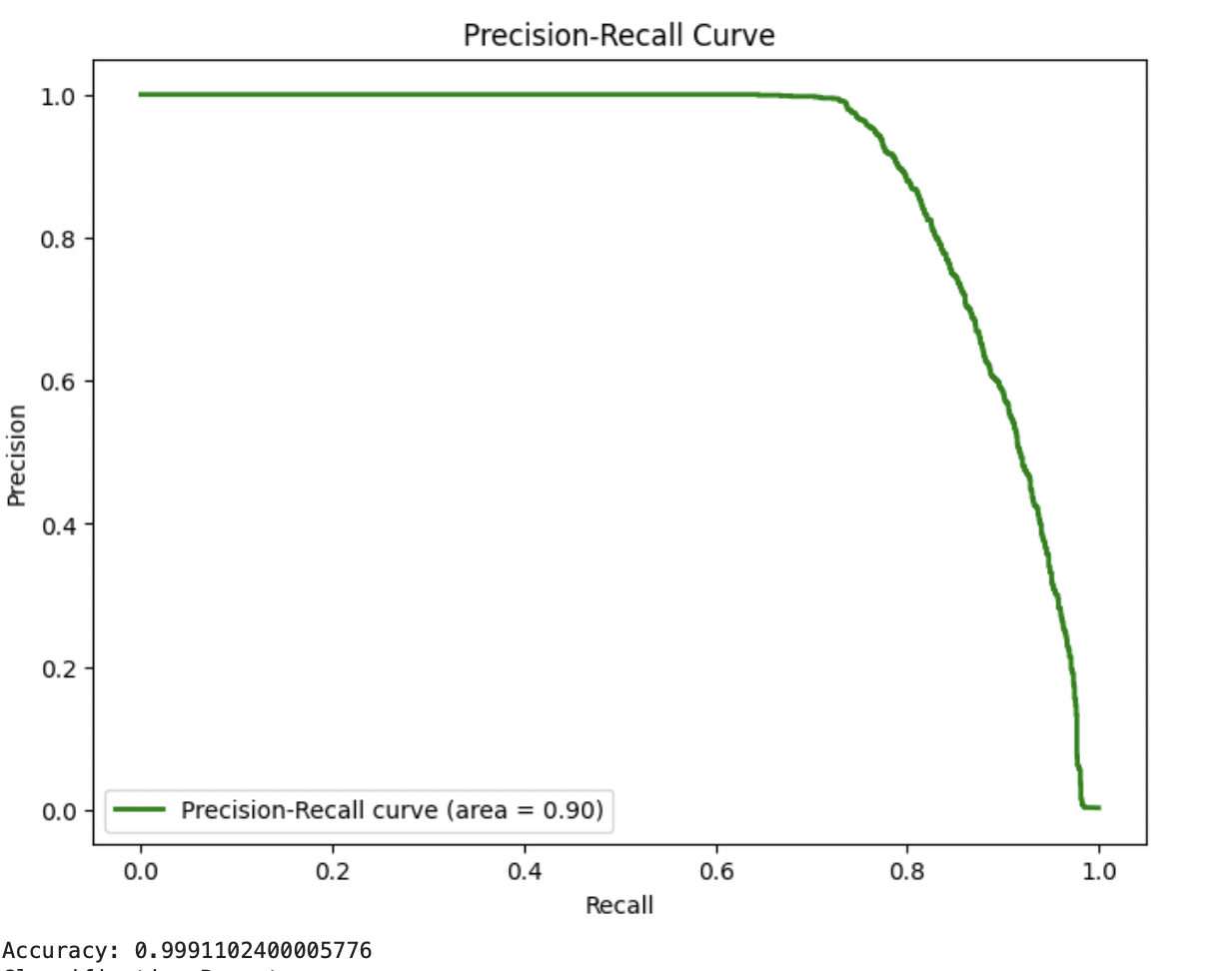
Neural Network
Hyperparameters😐 Network Architecture:
Training Hyperparameters:
Training Loop Settings:
Layers:The neural network model consists of three fully connected (linear) layers:
Input Layer:
The model achieved an accuracy of 99.91% on fraud detection, showing high performance in identifying fraudulent transactions. It provides detailed metrics such as precision, recall, and F1-score for both classes, indicating strong overall performance in distinguishing between legitimate and fraudulent transactions.
The methods used include defining a binary classification model in PyTorch, data conversion to tensors, creating datasets and data loaders, training the model using the BCE loss function and Adam optimizer, and evaluating the model using ROC curve, Precision-Recall curve, accuracy, classification report, and confusion matrix to assess its performance.
Hidden Layers:
Output Layer:
Epochs: The model is trained for 20 epochs

Slide 16

Transfer learning - Leveraging BERT for Fraud Detection
To Be Updated

Slide 17
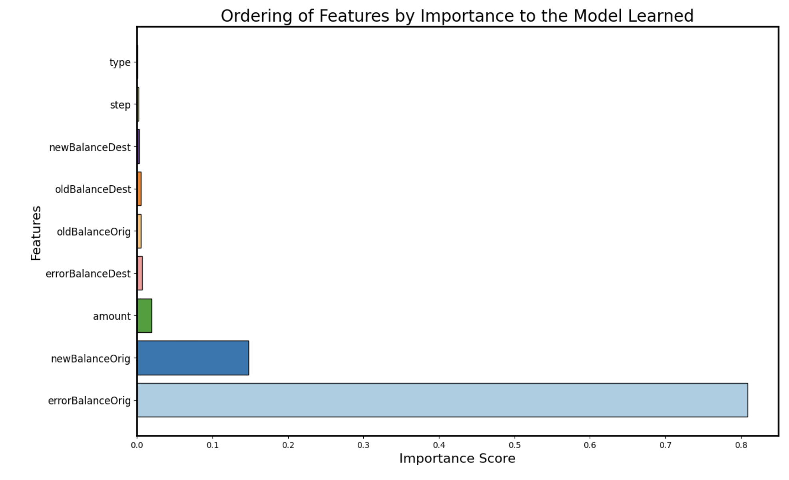
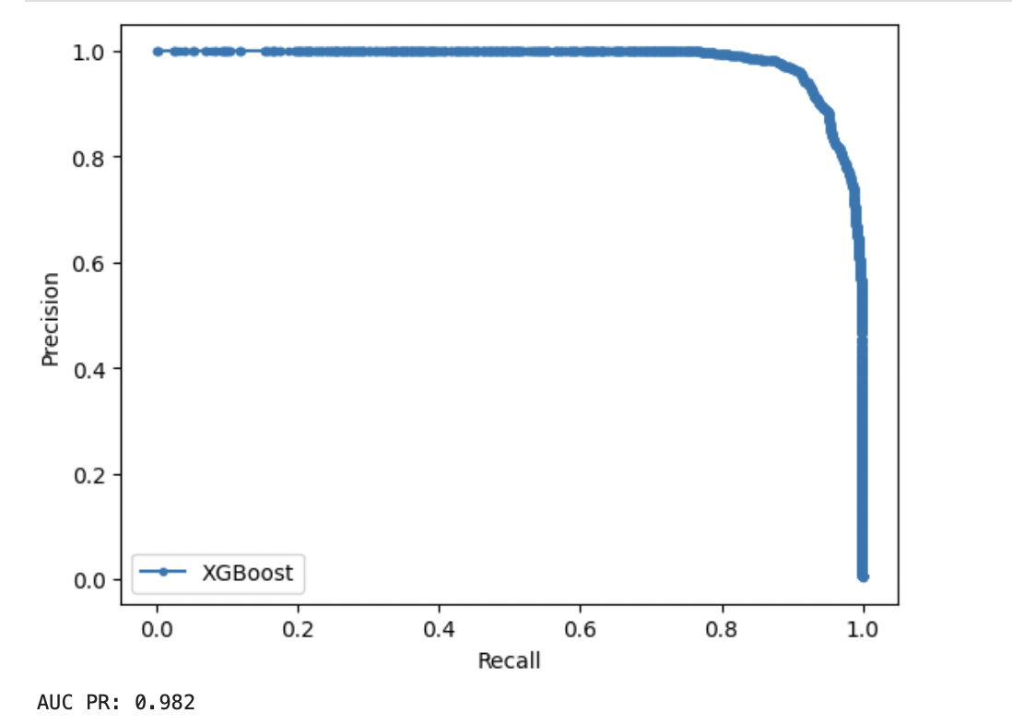
XGBoost Model for Fraud Detection
Chosen for efficacy in handling imbalanced data and accommodating missing values; Supports parallel processing
Inherently assigns different weights to positive and negative classes, aligning well with skewed data
Train : Test Data Split – 80:20
Performance Metrics
Precision | 95.09%
Recall | 88.27%
Accuracy | 99.95%
F1- score | 91.56%
AUC PR | 96.80%
The XGBoost model excels in fraud detection, demonstrating exceptional precision and recall balance, robust overall accuracy, and a high AUC PR score, making it a well-suited choice for effective identification of fraudulent transactions

Slide 18
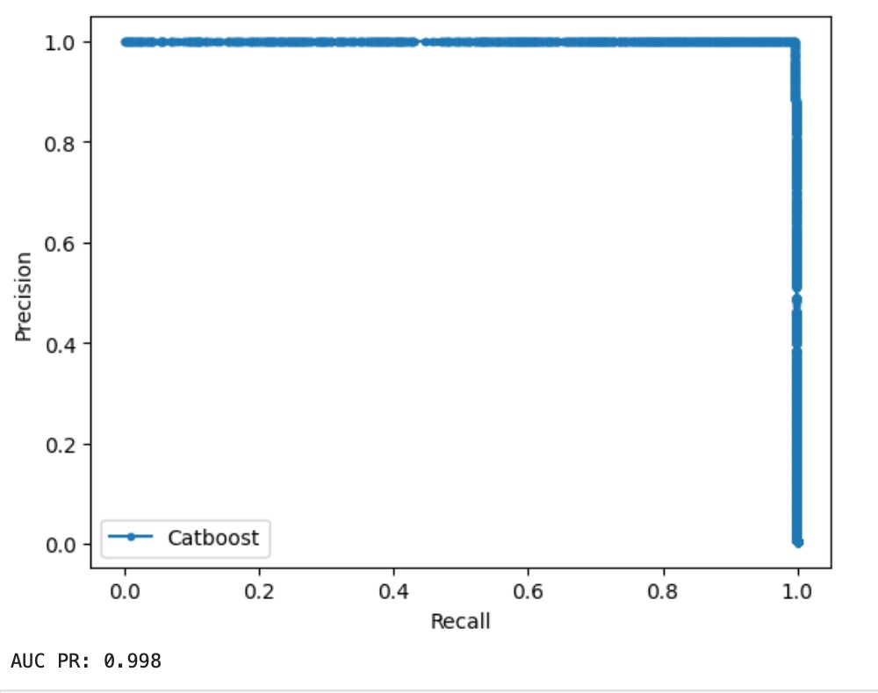
A Deep Dive into CatBoost Fraud Detection Accuracy
Train : Test Data Split – 80:20
Performance Metrics
Precision | 99.64%
Recall | 99.51%
Accuracy | 100.00%
F1- score | 99.57%
AUC PR | 99.70%
The CatBoost model demonstrates exceptional performance in fraud detection, with high precision, recall, accuracy, F1 score, and AUC PR score, indicating robustness and effectiveness in identifying fraudulent transactions

Slide 19
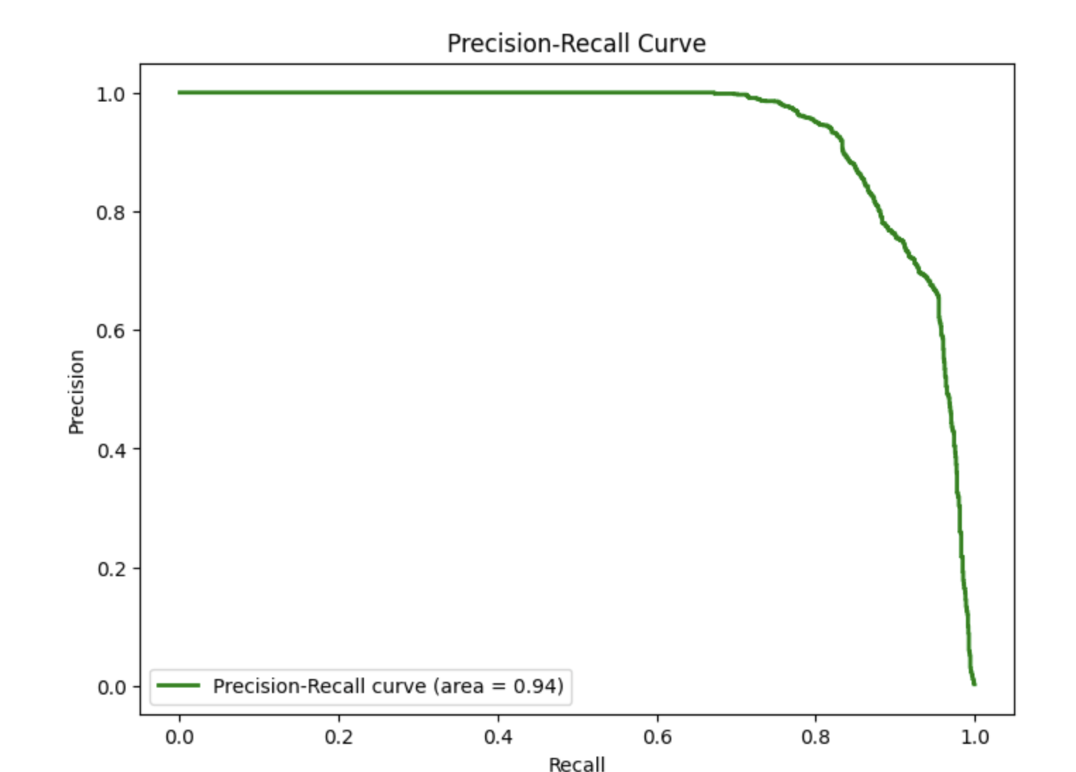
Optimizing Precision and Recall: SVM Insights
SVM Model Evaluation Metrics:
Precision-Recall (PR) curve is a key metric
Illustrates precision-recall trade-off for various thresholds
Performance Indicator:
High area under the PR curve (e.g., 0.94) signifies strong predictive ability
Trade-Off Analysis:
Precision-Recall curve illustrates the trade-off between precision and recall for different threshold values
AUC PR Score:
AUC PR of 0.94 indicates the model's effectiveness
Correctly identifies positive instances while minimizing false positives

Slide 20
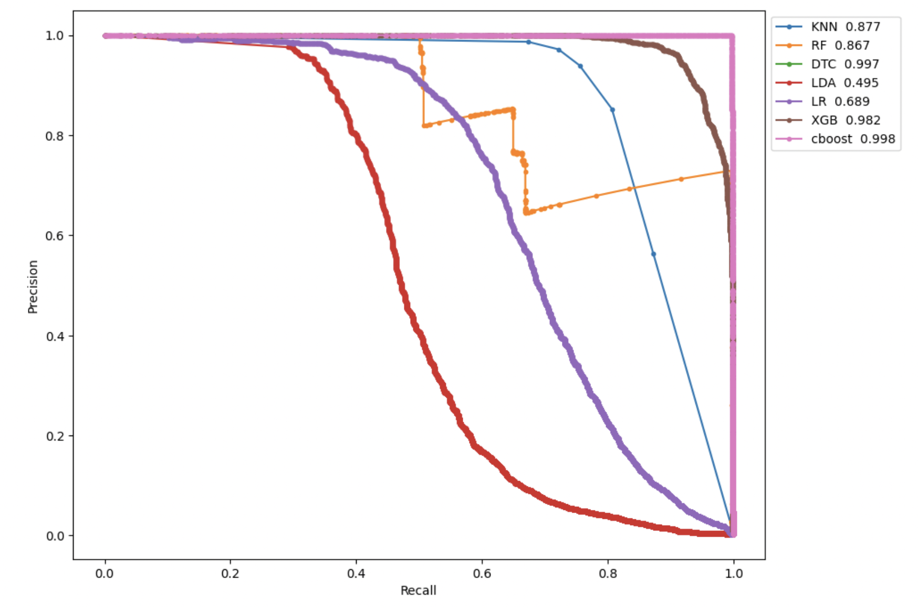
Interim Model Comparison Overview
We tried many models such as KNN, random forest, LDA, Logistic regression, CatBoost, XGBoost to see which models performs better:
Performance Metric:
AUC PR score used for precision and recall evaluation
Higher AUC PR indicates better performance, crucial in imbalanced datasets like fraud detection
CatBoost Superiority:
CatBoost stands out with the highest AUC PR score of 0.997
Demonstrates strong performance in identifying fraud cases while maintaining a balance between precision and recall
Other Strong Performers:
Decision Tree Classifier (DTC) achieved a score of 0.995
XGBoost (XGB) performed well with a score of 0.968
Interim Recommendation:
CatBoost is recommended for fraud detection in this scenario due to its superior AUC PR performance compared to other models

Slide 21
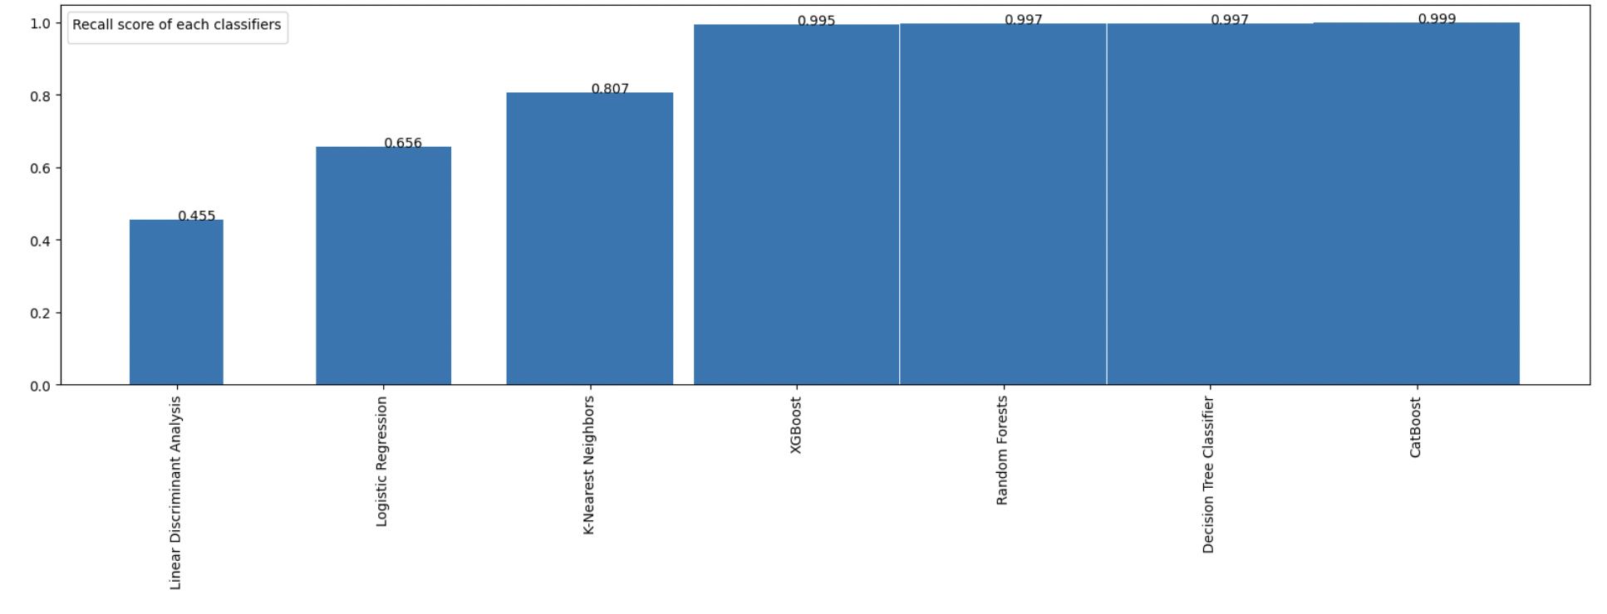
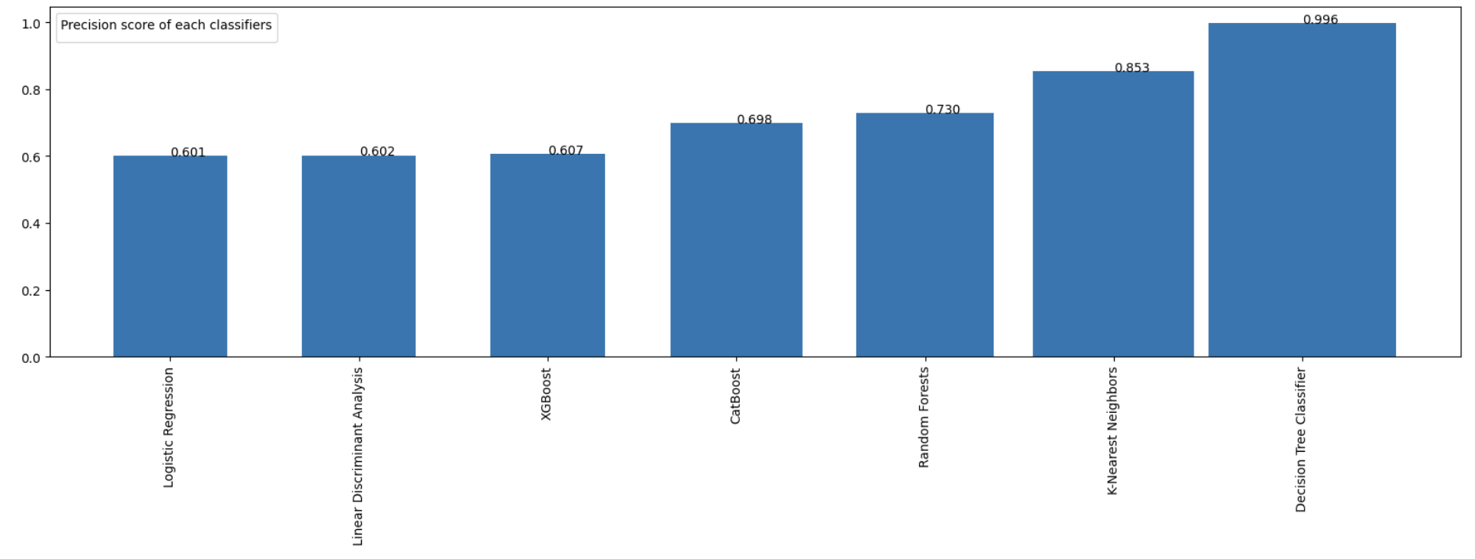
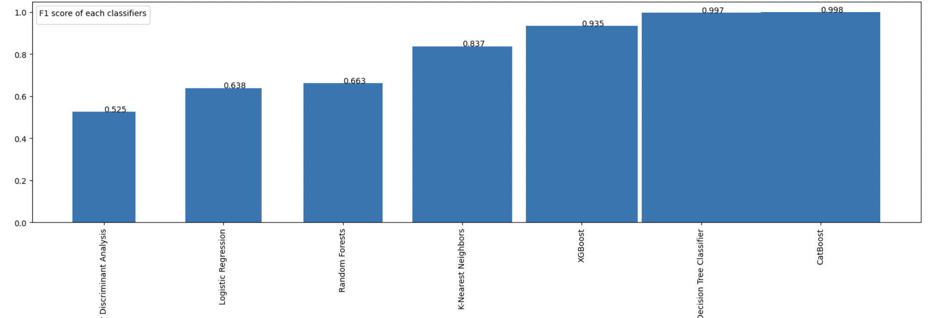
Comparison
To Be Updated
RECALL
CatBoost has a high recall score
PRECISION
Decision Tree has a high recall score
F1-SCORE
CatBoost has a high recall score

Slide 22
Conclusion
To Be Updated: Amount of text to be reduced
Logistic Regression (LR) and Linear Discriminant Analysis (LDA) models exhibited poor performance due to two fundamental challenges within the dataset: severe class imbalance and non-linear separability of the data
In our endeavor for Outlier Detection, we employed various methodologies. Z-score exhibited success in detecting outliers while methods like LOF (Local Outlier Factor), Isolation Forest, and Elliptic Envelope showcased high precision but struggled with recall. Given the emphasis on fraud detection where a high recall rate is pivotal, these models didn't deliver optimal performance
Ensemble methods, particularly CatBoost, emerged as robust performers when handling imbalanced datasets. The ensemble techniques demonstrated a notable ability to tackle the class imbalance issue effectively.
Our exploration also included neural network models, which exhibited strong performance in handling the complexities of the dataset, showing promising results for fraud detection tasks.
Leveraging a pre-trained model like BERT specifically for fraud detection proved to be a promising approach, delivering encouraging outcomes.

Slide 23
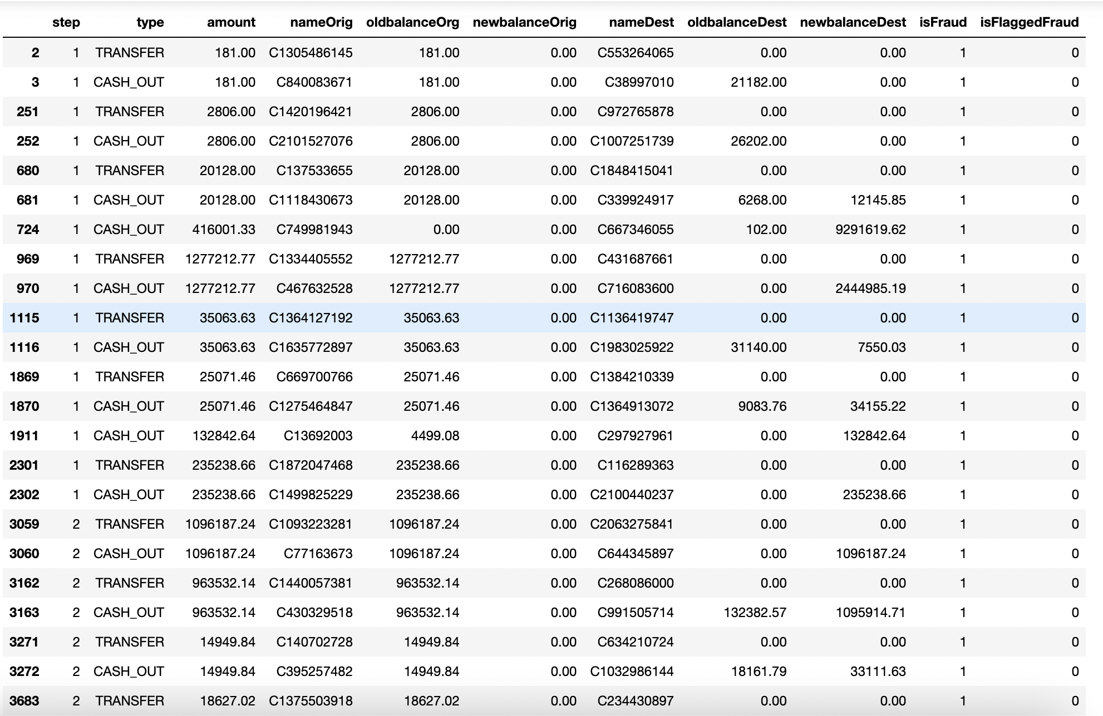
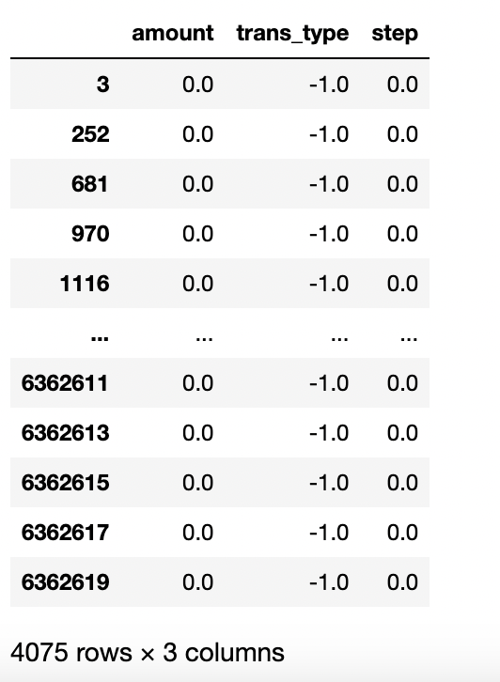
Temporal Trend
Temporal trend in the dataset if we look at the index, step, amount, trans_type(transfer and cash_out) we figured out that when there is 1 hour interval between transfer and cash_out and the amount transfer and cash_out is same the transaction is Fraud.

